Slide 1




A fiery approach to r web services
Exposing your models as web services in R...
@quintindk
https://github.com/quintindk
https://linkedin.com/in/quintindk

Slide 2

About me...

Slide 3
About me...

Slide 4
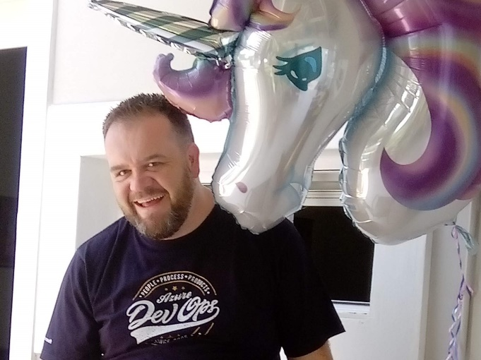
About me...
I’m a proud father and husband.
I’ve been in the technology industry for 20 years.
Of that 20 years, almost 11 years have been at Netstar.
My background is software development; .NET, JS, Python, R, Scala, Java.
My interests outside of Technology are reading of which I enjoy mostly psychology, philosophy and anthropology.

Slide 5
Fiery Web Services
ProjectTemplate - http://projecttemplate.net/
Fiery - https://github.com/thomasp85/fiery
Docker - https://www.docker.com

Slide 6

ProjectTemplate
is a system for automating the thoughtless parts of a data analysis project...
Organizing the files in your project.
Loading all the R packages you’ll use.
Loading all of your data sets into memory.
Munging and preprocessing your data into a form that’s suitable for analysis.
http://projecttemplate.net

Slide 7
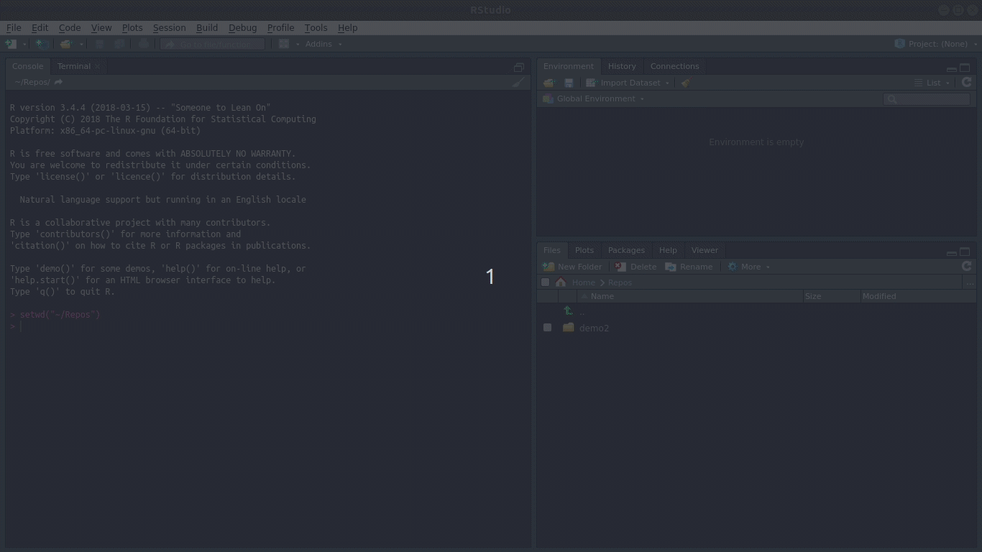

Slide 8
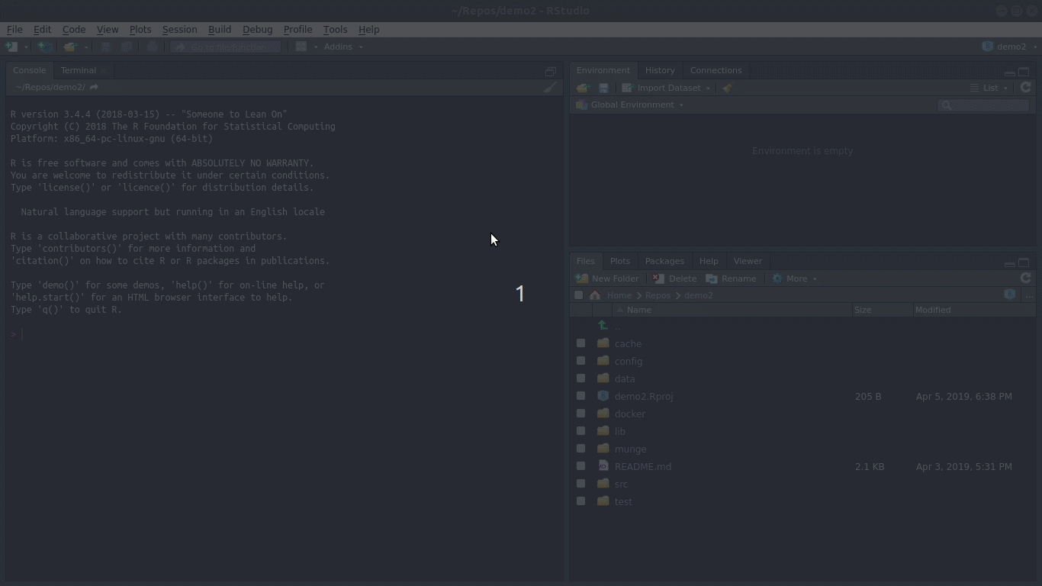

Slide 9
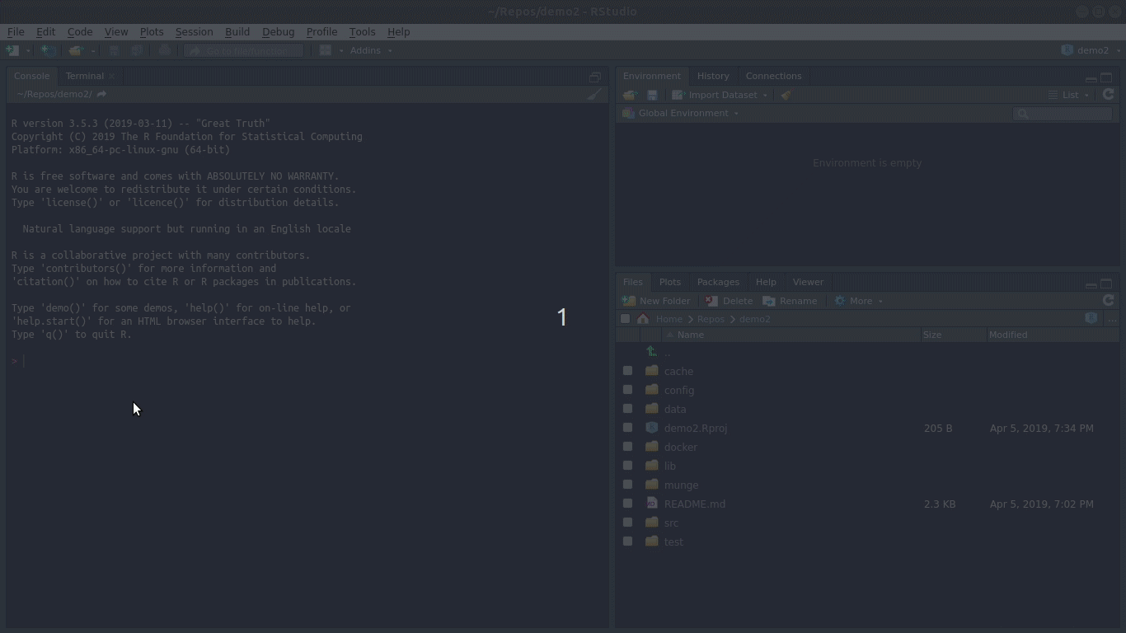

Slide 10

Fiery
This package maintained by the infamous Thomas Lin Pedersen @thomasp85 (think gganimate) is a framework for web servers in R.
Fiery is a flexible and lightweight framework for building web servers in R. It is relatively unopinionated about how you chose to build your server logic and supports many use cases, from serving static files to being used as a base for a model-view-controller based setup.
https://github.com/thomasp85/fiery

Slide 11
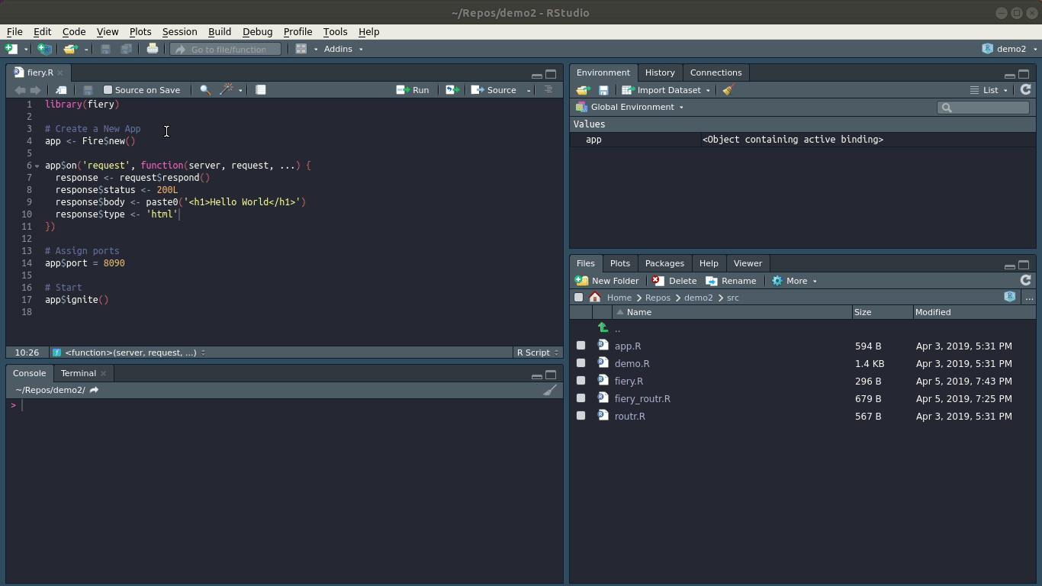

Slide 12
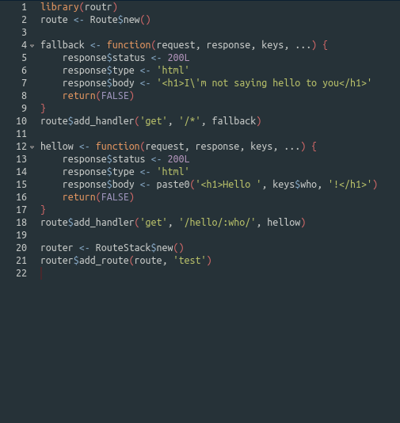
routr...
Middleware that delegates the HTTP request to the handler function
Delegation is URL based.

Slide 13
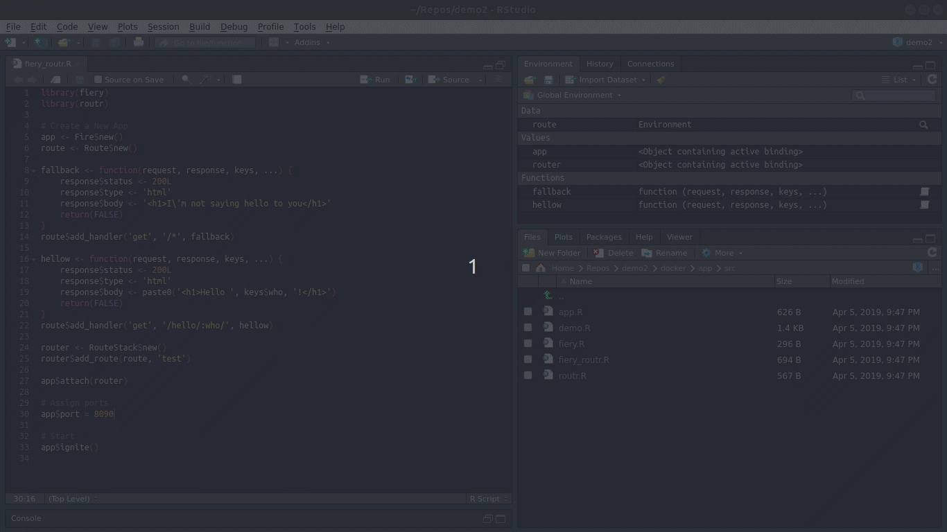

Slide 14
ProjectTemplate and Fiery
Model View Controller pattern...

Slide 15
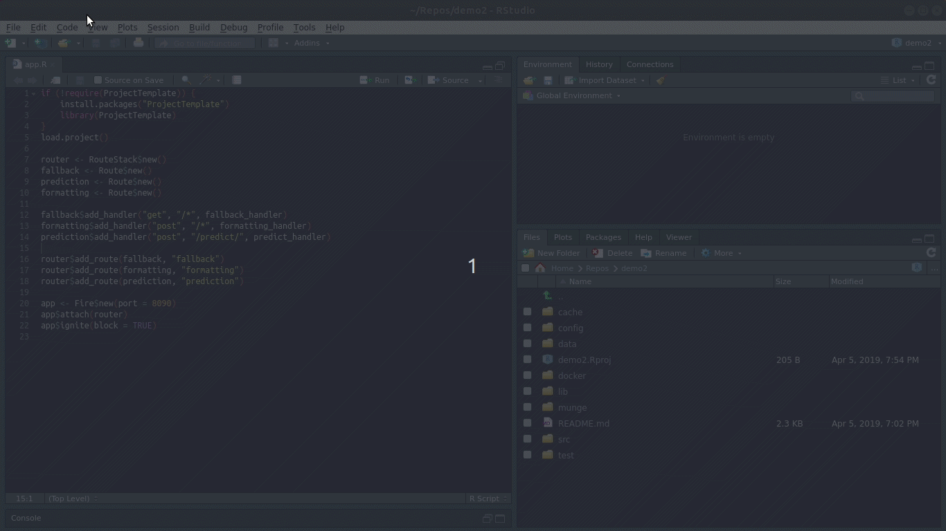

Slide 16

Docker
is a system for virtualizing software at an OS level...
Docker was open sourced in 2014
Containers take away the complexity of installation at scale
Stephan Fabel (Product Manager at Canonical) is quoted as saying “The containerization craze shows no signs of abating”
https://www.docker.com/

Slide 17
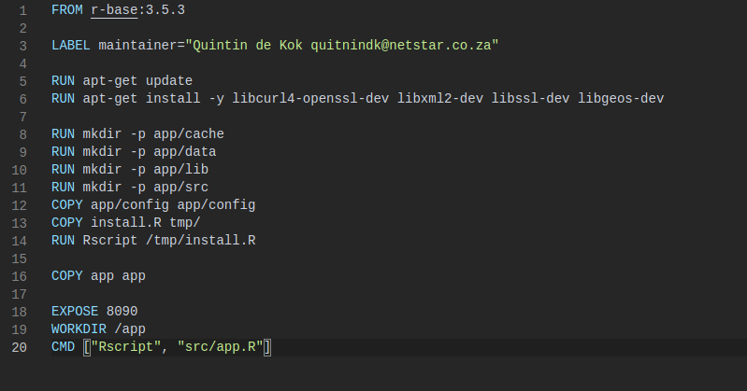
Dockerfile

Slide 18
Dockerfile

Slide 19
Dockerfile

Slide 20
Dockerfile

Slide 21
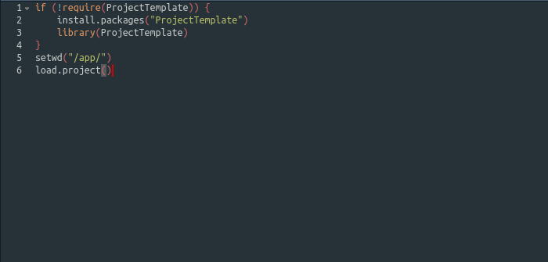
Install.R

Slide 22
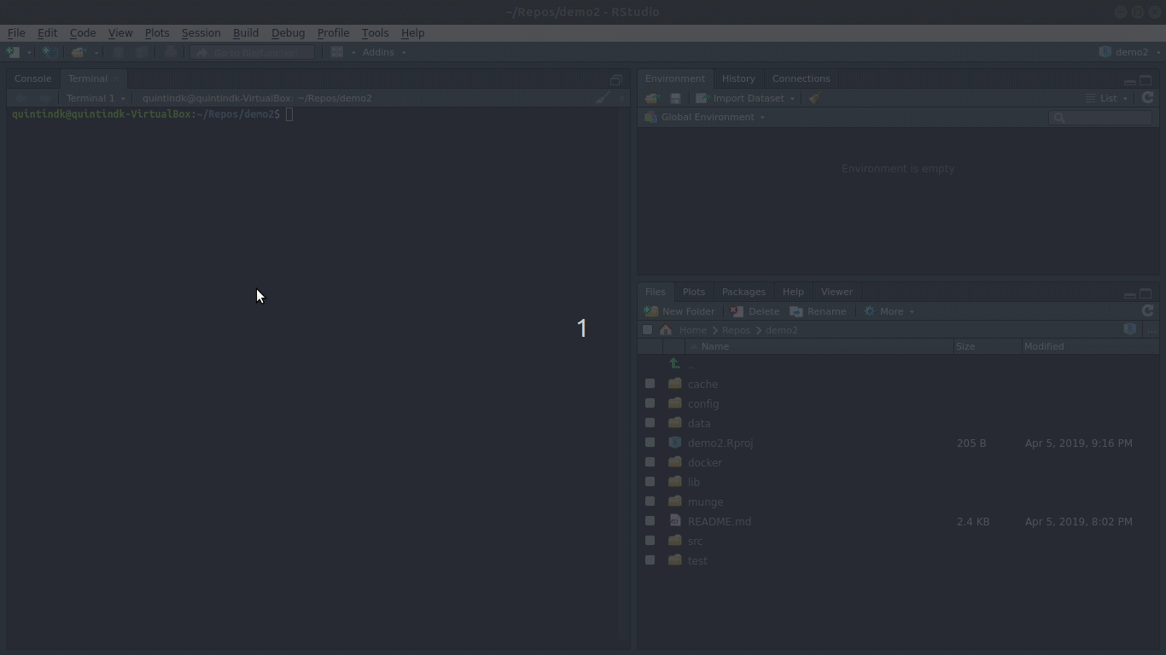

Slide 23
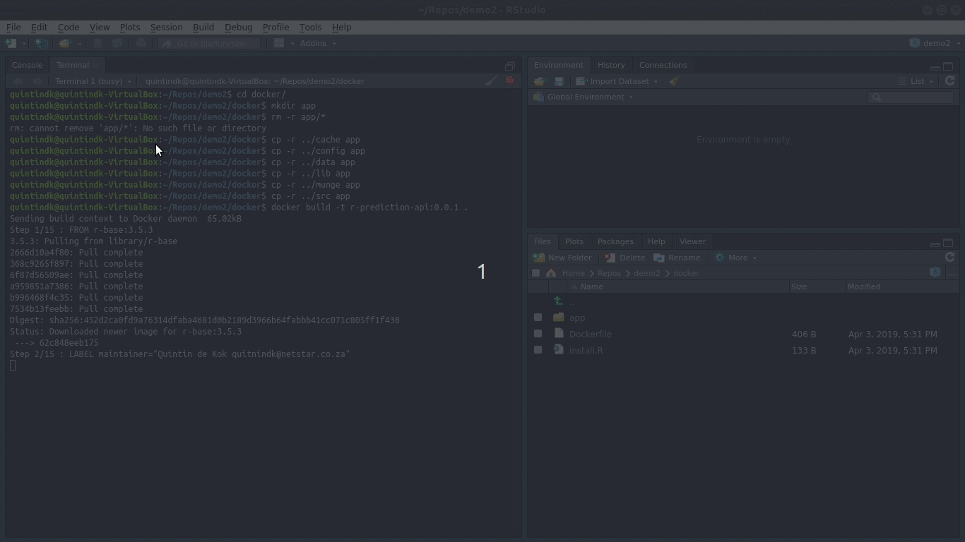

Slide 24
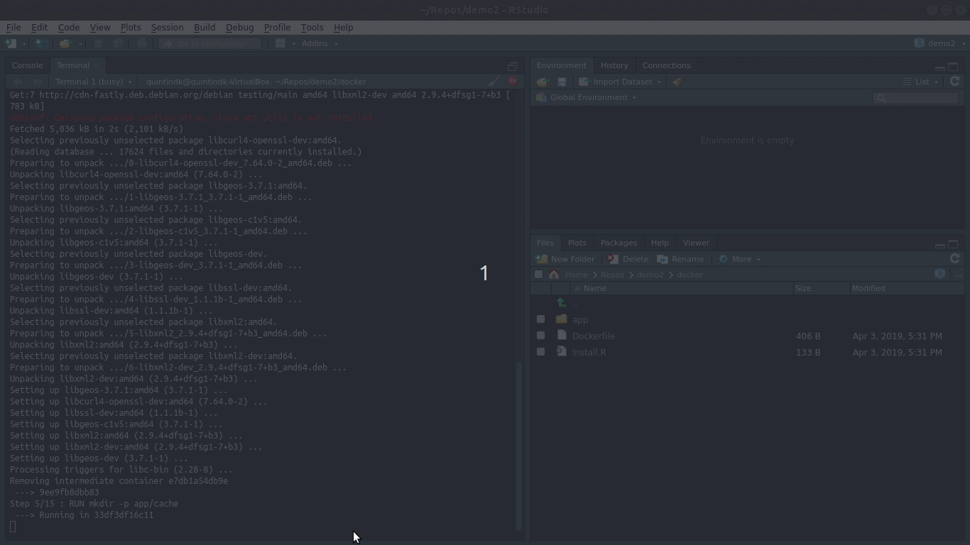

Slide 25
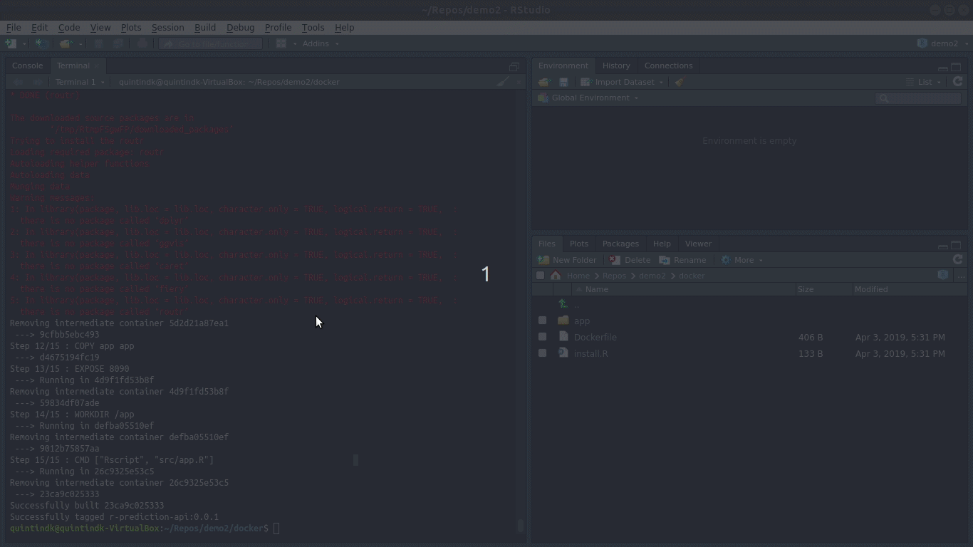

Slide 26
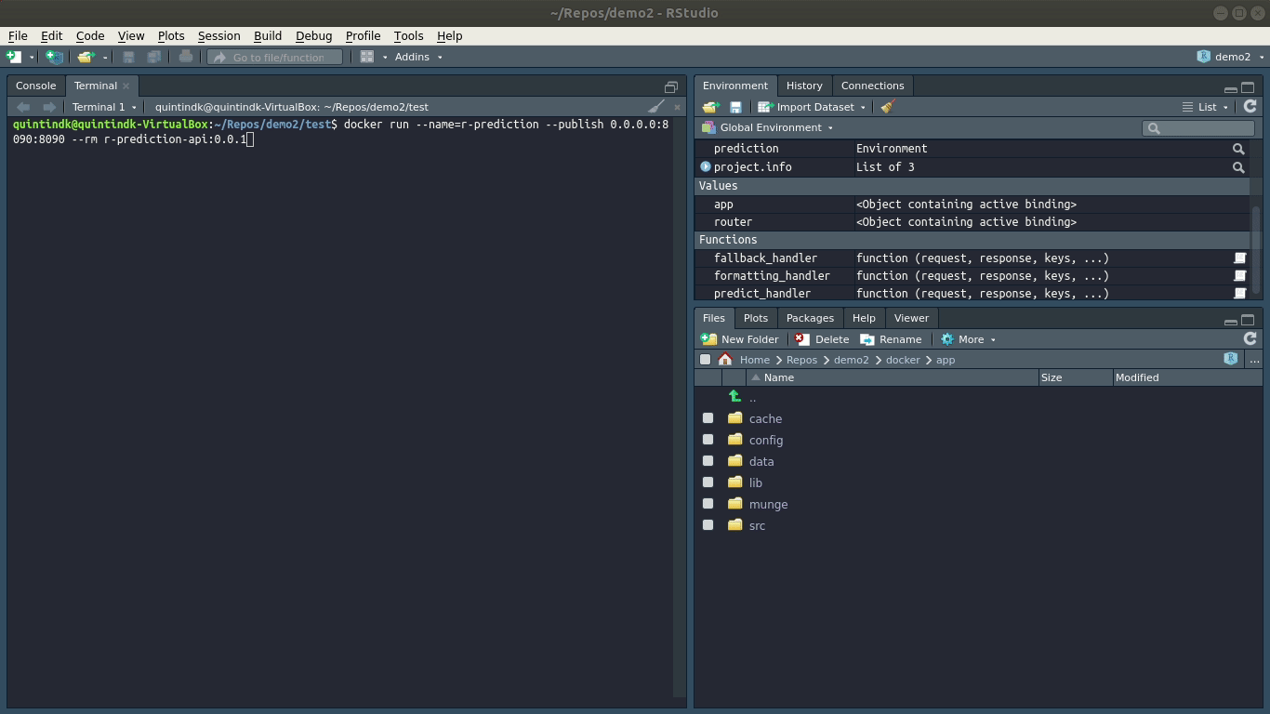

Slide 27
THANK YOU
@quintindk
https://github.com/quintindk
https://linkedin.com/in/quintindk

Slide 28
https://www.rstudio.com
http://projecttemplate.net
https://github.com/thomasp85/fiery
https://github.com/thomasp85/routr
https://www.datacamp.com/community/tutorials/machine-learning-in-r
https://github.com/quintindk/satRday-demo-2019
@quintindk
https://github.com/quintindk
https://linkedin.com/in/quintindk

